Slide 1
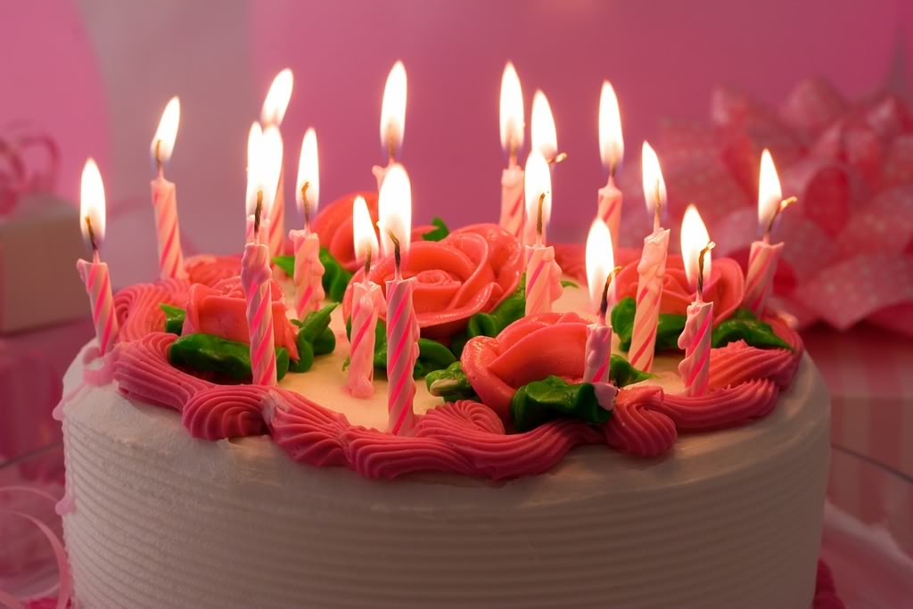
HAPPY BIRTHDAY , JILL !
CAKE
PRESENT

Slide 2
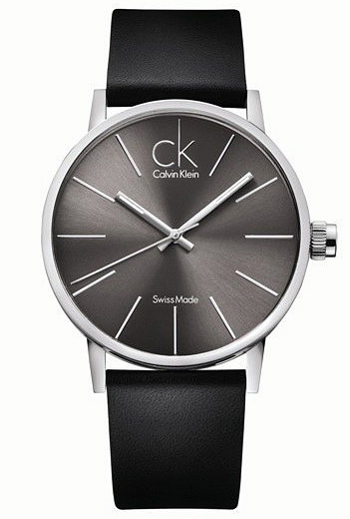
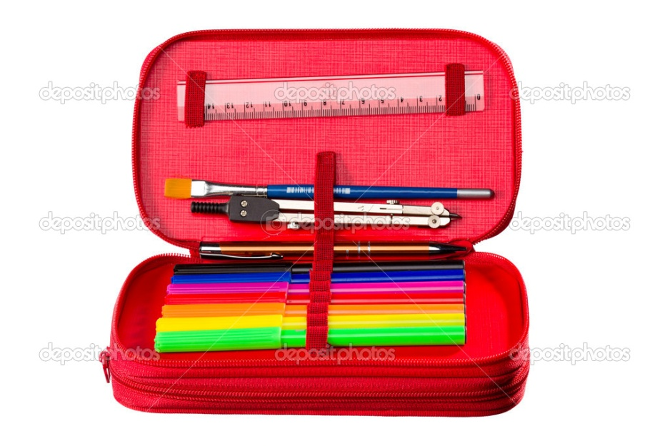
WATCH
tch – [t∫] - ч
Pencil case

Slide 3
p.6, ex. 3
How old is DAN?
How old are you?
He is eight .
I am … .

Slide 4
Вспомни как читается Uu буква в открытом слоге
music
[ju:] - ЮЮ
Mum
[^] - a

Slide 5
[ju:] - ЮЮ
Music
Computer
Use

Slide 6
[^] - a
mum
up
nut
number

Slide 7
[au] - ау
house
mouse
ground
mount

Slide 8
Home work
c.41, упр.A,B (p.т.)

